Slide 1
Video Cloud Analytics
Lawson Hancock
Senior Product Manager

Slide 2
VIDEO CLOUD ANALYTICS OVERVIEW
Analytics in Studio
Custom Reporting Solutions
Analytics API (Limited Availability)
Report Generator (Q4, 2014)

Slide 3
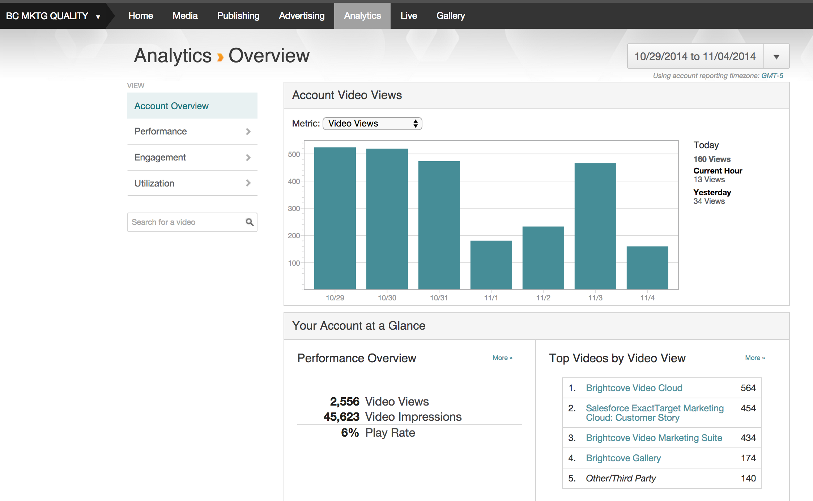
VIDEO CLOUD ANALYTICS OVERVIEW
Analytics Dashboard
Overview Page
Reports:
Performance
Engagement
Utilization
Export (XLS or CSV)
Metrics
Players Loads
Video Impressions
Video Views
Referring Sites
Device Types and OS
Geos
Minutes viewed
Engagement Scores
Display Domains
Browsers
Search Terms

Slide 4

Video Cloud Analytics Roadmap for 2015
Customer Visits Underway:
Digital Media
Digital Marketing
Based on SyncDev Methodology:
Cross-functional team “Jury”
VC Analytics 2015 “Product Pitch”
Structured Customer Feedback (e.g. $100 Test)

Slide 5
Brightcove Analytics API
Robert Crooks
Director of Brightcove Learning Services

Slide 6
AGENDA
The Analytics Module
The Analytics API
Analytics API solutions

Slide 7
The Analytics API

Slide 8
The Analytics Module
Fully GA now
Gets all its data from the Analytics API
A lot there now
Export data as CSV or XLSX file
Coming: Custom Report Generator

Slide 9
The Analytics API

Slide 10
THE NEW ANALYTICS API
A REST-based API that you can access from any programming language/application
Allows you to retrieve the data directly and use it in any way you like (as JSON, CSV, or XLSX*)
Provides account rollups and detailed reports
Multiple dimensions and filters to allow you to retrieve just the data you want
Sample request (report):
https://data.brightcove.com/analytics-api/videocloud/accounts/20318290001/report?from=2014-01-01&to=now
Sample request (account rollup):
https://data.brightcove.com/analytics-api/videocloud/accounts/20318290001?from=2014-01-01&to=now
Note: you may see older samples that use /account/ instead of /accounts/ - /account/ is still supported, but deprecated
* Getting XLSX data back from your own app not trivial

Slide 11
SERVICE URL AND AUTHORIZATION
Service URL:
https://data.brightcove.com/analytics-api/videocloud
Authorization via OAuth2 Bearer token
Passed as request header:
Authorization: Bearer access_token
Note: Early Limited Access customers have permanent tokens – going forward everyone will use our OAuth services to get temporary access tokens, as we will do in the exercises

Slide 12
DIMENSIONS
These are data buckets you can query and/or filter on (equivalent to SQL group by)
Query dimensions:
&dimensions=player,video
Filter on dimensions:
&where=player==12345;video==67890
Returned metrics vary by dimension
(Some) dimensions can be combined (which ones not quite finalized)
Filters can take multiple values:
videos==12345,67890 – interpreted as video=12345 OR video=67890
video
player
account
day*
country
city
region
referrer_domain
source_type
search_terms
device_type
device_os
* The dev team does not recommend using day as a filter – note that &where=day==2014-01-01 will get you the same results as &from=2014-01-01&to=2014-01-01 and the latter is the recommended way

Slide 13
PARAMETERS
Limit or modify the returned data items in various ways
Date/Time:
&from=2013-12-16 or alltime (alltime only works for reports, not rollups) or epoch time in milliseconds
default is 30 days before now
time of day only supported for epoch time in milliseconds and applicable only to data for previous 30 days
&to=2014-01-10 or now or epoch time in milliseconds
default is now
time of day only supported for epoch time in milliseconds and applicable only to data for previous 30 days
Filters: &where=dimension1==value1;dimension2==value2
Paging: &limit=20&offset=40 (limit default is 10; offset default is 0)
Fields: &fields=video_view,engagement_score (default is video_view; possible values depend on dimension; fields=all to return all fields)
Sorting: &sort=engagement_score (must be a metric returned for the dimension(s))

Slide 14
Sample Solutions
Report by Player and Day
Most Popular Videos

Slide 15
TWO BASIC CATEGORIES OF SOLUTIONS
Custom Reports
Get a specific data-set that the built-in reports don’t provide
Represent the data differently
Example:
http://solutions.brightcove.com/bcls/analytics-api/video-reports-by-player-and-day/video-reports-by-player-and-day.html
Do something (like create a playlist) based on analytics data
Most popular videos
Trending videos
Choose most popular among a set of relevant videos
Example
http://solutions.brightcove.com/bcls/analytics-api/most-popular-videos.html

Slide 16
Exercise 1
Get Client Credentials for the Analytics API

Slide 17
Get Client Credential
Open studio.brightcove.com
Click the gear icon and go to API Authentication
Click Register New Application
The name and description are optional
Choose one or more accounts and add them to Selected Accounts
Select Read under Analytics under the Exposed Brightcove APIs
Click Save
Be sure to copy and save the Client ID and Client Secret that appear in the popup box

Slide 18
Exercise 2
Get Analytics by Custom Field

Slide 19
Setup
In this exercise we will use the Media API and Analytics API together to create a report on analytics for videos that have a certain custom field value
You will need a Media API read token for the account that you just got client credentials for
Because we can’t access the OAuth API from a web page, we will route the request through the Learning Services Analytics API proxy to get the access token: http://solutions.brightcove.com:8002
Exercise files are in http://files.brightcove.com/analytics-exercises.zip (you need to save the files somewhere under the document root of your local web server)
We will used the bc-mapi.js wrapper for the Media API calls
I’ve done the tedious humdrum part of the HTML/JS for you

Slide 20
The Media API Part
Open analytics-exercise.html in the analytics-exercises folder
Find the getVideos() function and copy and paste the contents of mapi-request.js after the // mapi-request.js goes here comment
Find the onMapiResponse() function and copy and paste the contents of mapi-response.js after the // mapi-response.js goes here comment
Save and browse the page (through your local web server) to test the Media API call

Slide 21
The Analytics API Part
Find the submitRequest() function and copy and paste the contents of analytics-request.js after the // analytics-request.js goes here comment
Save the file and browse it to test the Analytics API request

Slide 22
Thank you
All materials used in this session are available at:
https://github.com/BrightcoveLearning/Analytics-API-Training

